Slide 1
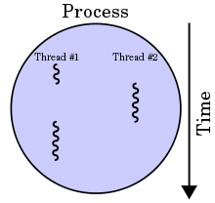
Processes and Threads
Single Application running in OS is a process. A process can have multiple threads.
Spell checker in Microsoft word application can be considered as a Thread and Microsoft word application is a process.
Microsoft word application, It is a single process and when you type in word, a spell checker will keep working in the background to correct your words, this job can be considered as a thread.
Java application running in a system is a process and can have multiple threads inside it
A thread is nothing but a thread of execution which executes the code.
When you use java class – your main method starts getting executed – It means that the JVM is creating a thread to start executing the code in main method and we call this method as Main thread.
It is the Operating System which schedules the threads to be processed by the Processor. So the scheduling behavior is dependent on the OS. Again there is a Thread Scheduler inside JVM which coordinates with OS scheduler.
A process with two threads of
execution, running on a single
Processor.

